Slide 1
7.2 Maximum of Brownian motion with Drift
財金 洪敏誠
2009/09/22

Slide 2
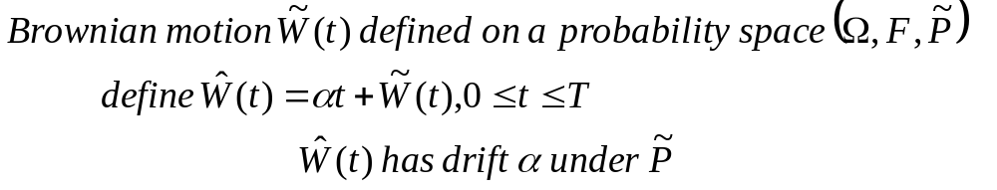
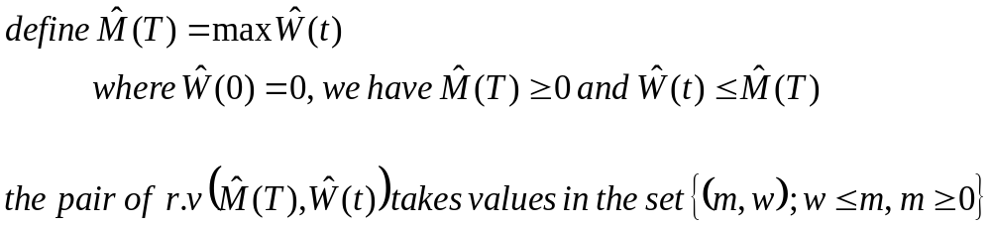

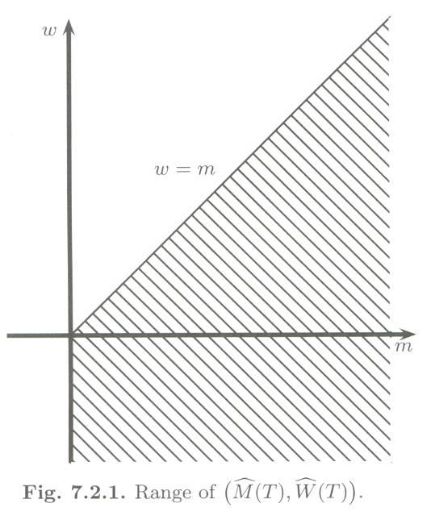

Slide 3
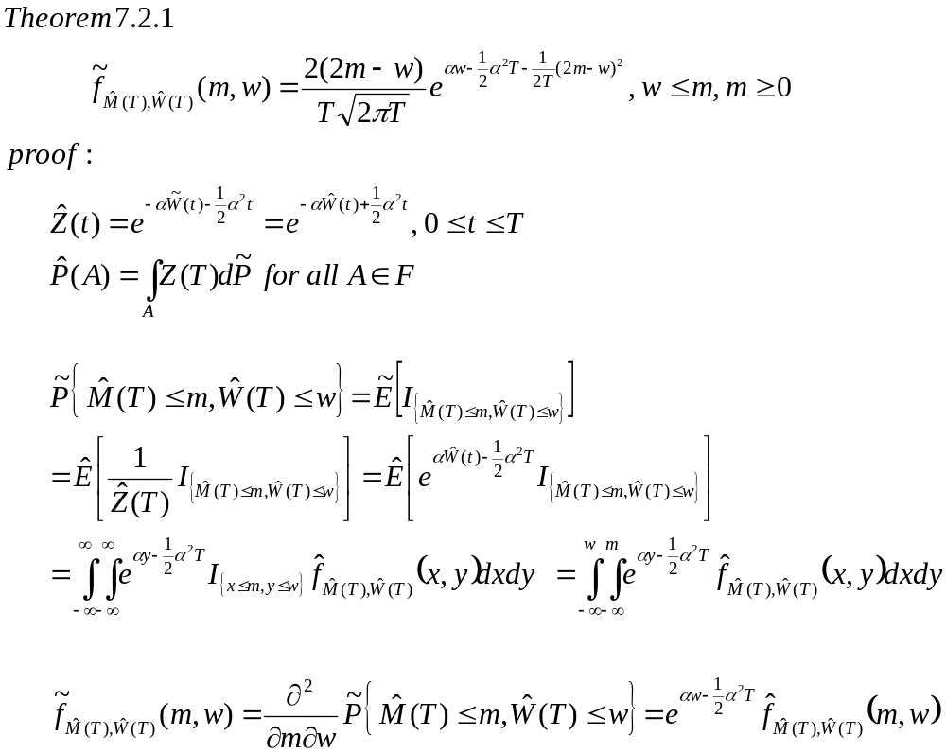
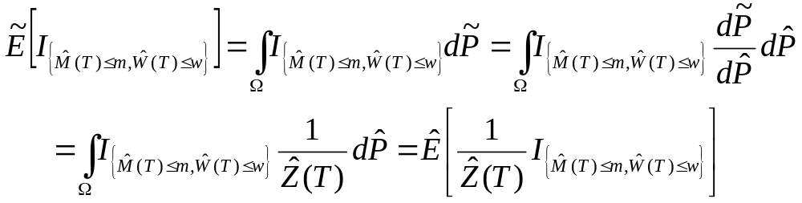
Girsanov’s Theorem
Joint c.d.f
Joint p.d.f

Slide 4
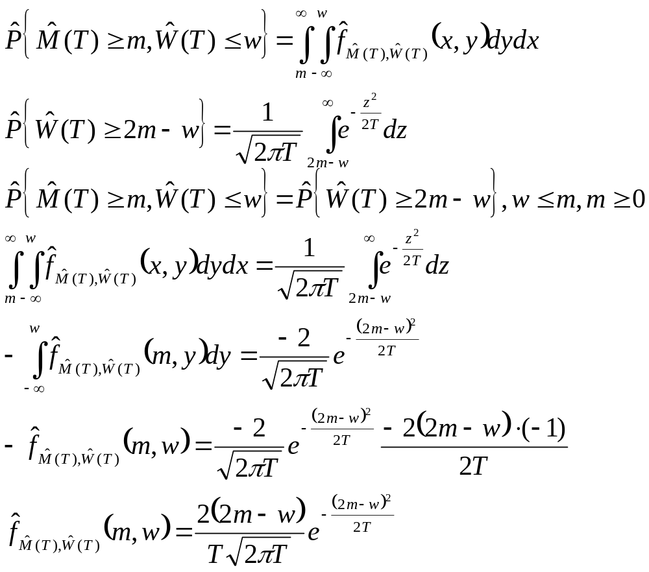
壹、
貳、
參、
=>
Reflection principle

Slide 5
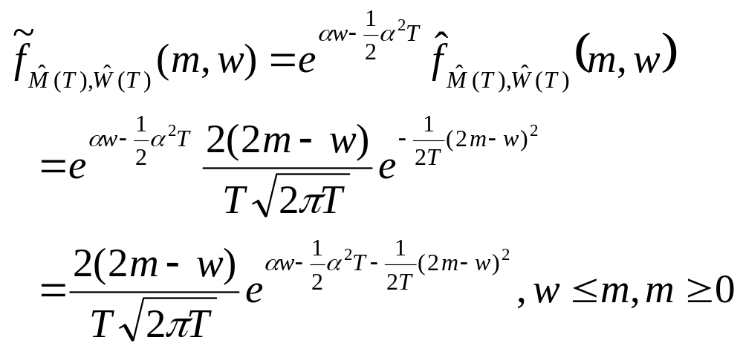

Slide 6
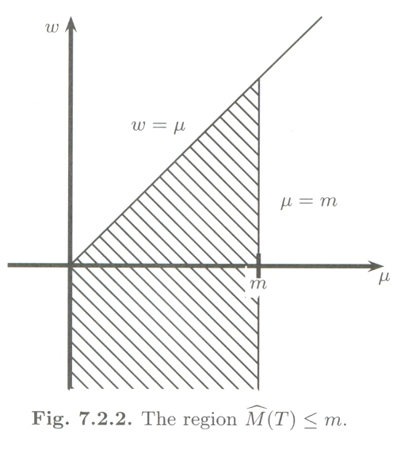
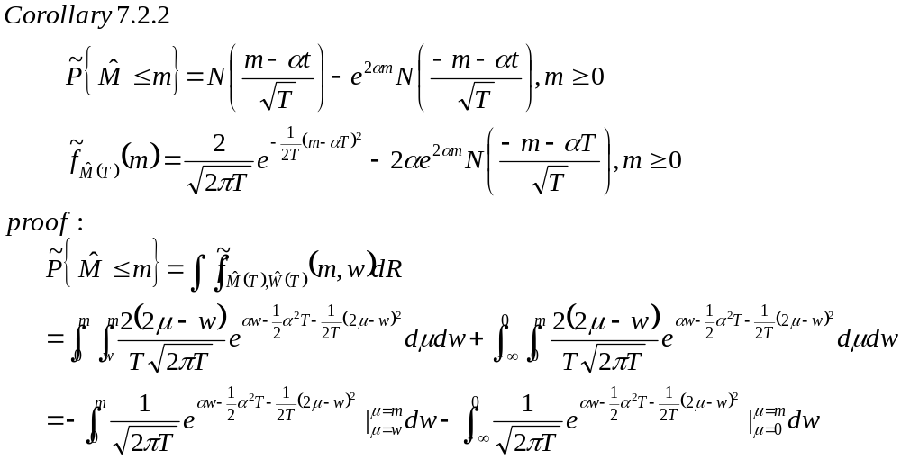
A1
A2
Marginal c.d.f
A1
A2

Slide 7
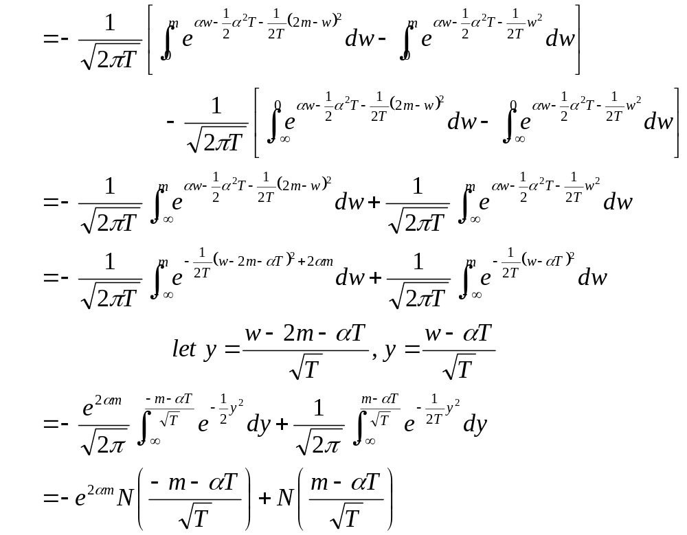
Chang variable

Slide 8
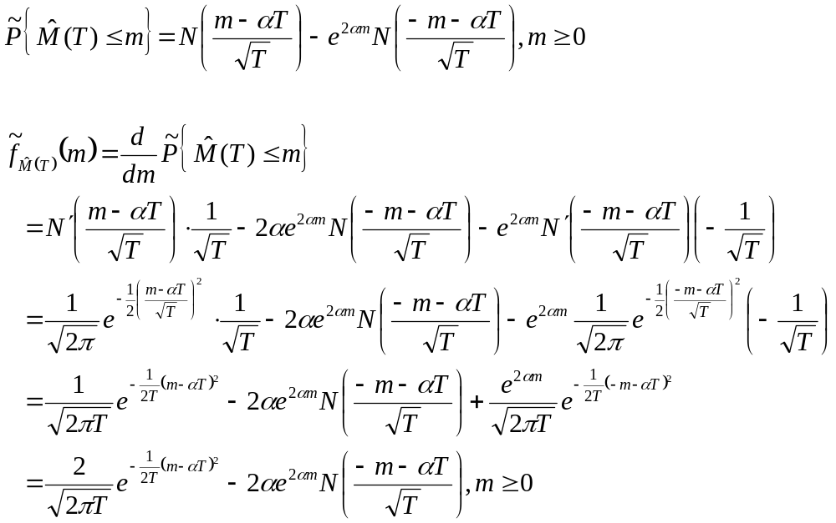
Marginal p.d.f

Slide 9
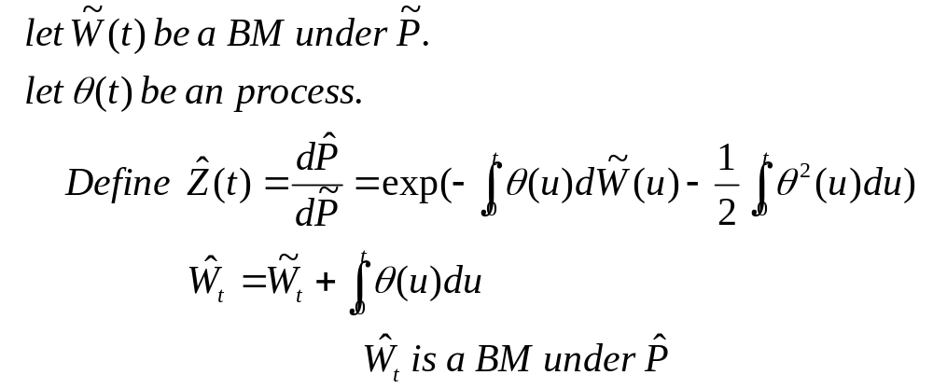
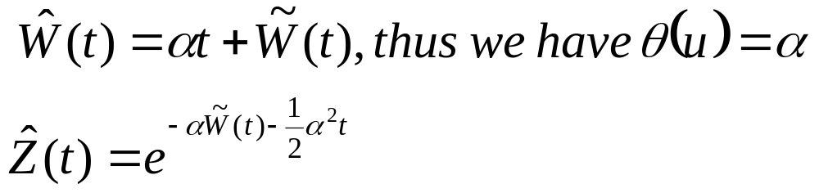
Girsanov Theorem
Radon-Nikodym density
Our case:
Back

Slide 10
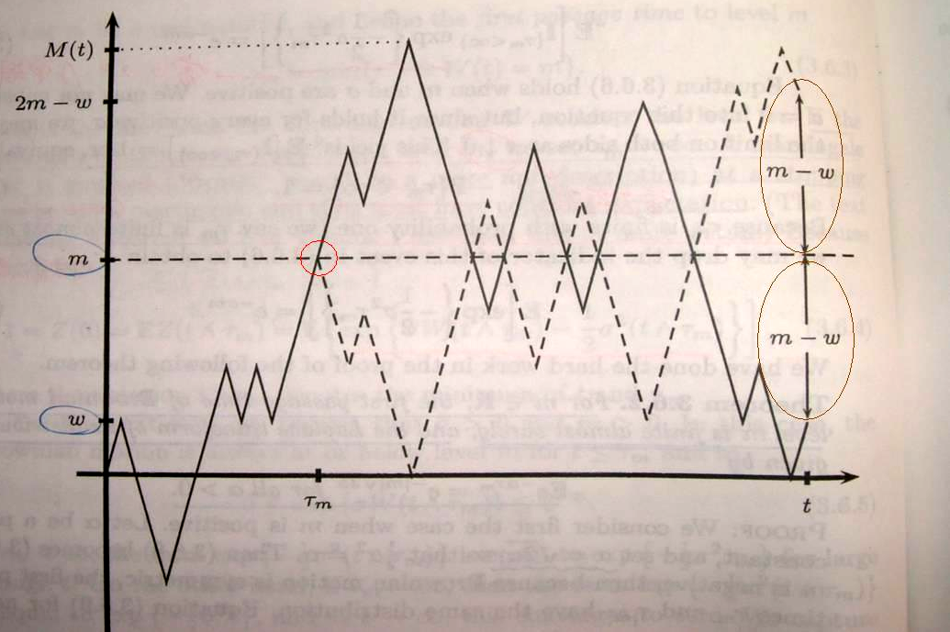
Reflection principle
Back

